Slide 1
USE CASE
Medical Billing
Simplifying the path to automation for SMB.

Slide 2
Summary
Automate repetitive tasks using Digital Workers to scale productivity and profitability for your medical billing and revenue cycle management firm.
1/
2/
Digital Workers are trained to enter EHR, medical codes and process claims automatically.
Digital Workers cost a fraction of a full time employee (FTE).
3/
4/
Digital Workers work at the speed of digital so they are able to shorten revenue cycles for clients.
Digital Workers reduce errors, never take a vacation, require a promotion, and keep overhead low.
Simplifying Digital Automation for SMB
2

Slide 3
What Manual Processes Drain Profitability?
Let's work together to automate these headaches:
Automate Patient Registration
Automate Charge Capture
Automate Claim Submission
Automate Claim Processing
Automate Payment Posting
Automate Patient Billing
Simplifying Digital Automation for SMB
3

Slide 4
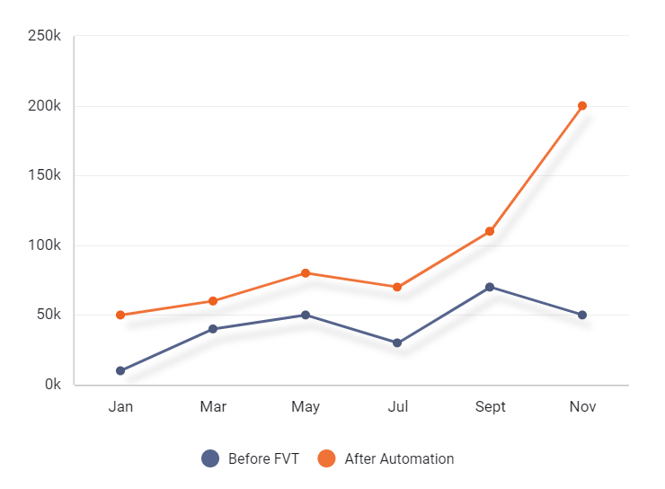
NBBT for Medical Billing & Revenue Cycle Management
Process Automation Increases Profitability Over Time
TAKEAWAY:
Scalable Process Execution
With Digital Workers, profitability increases over time since an increase in revenue doesn't run parallel with headcount.
Simplifying Digital Automation for SMB
4

Slide 5
Overview
Digital Workers are powered by software and uniquely designed by FVTech to follow any digital process using email, desktop applications, files, and web applications.
1/ Data Entry
2/ Documents
3/ Complex Workflows
Digital Workers Perform Data Entry
Digital Workers Read & Process Documents
Digital Workers Automate Complex Workflows
Simplifying Digital Automation for SMB
5

Slide 6
Designing Digital Workers
We handle all of the heavy lifting.
Production
Discovery
Signed Contract to Put Digital Worker into Production
Identify Opportunities for Automation
Design
We Program the Digital Worker to Complete Each Step in the Process
Today
Launch
Demo Our Platform
Sandbox
Understand Capabilities and How Digital Workers Operate
We Provide You With the Digital Worker Prototype
Simplifying Digital Automation for SMB
6

Slide 7
The Numbers Are Astounding
Are you ready to step into the future with FVTech:
62%
decrease in clerical data entry errors using automation speeding revenue cycle
75%
increase in productivity for Digital Workers VS. manual data entry
100%
customer satisfaction guaranteed with FVTech Digital Workers
Simplifying Digital Automation for SMB
7

Slide 8
FVTech exists to help SMB achieve breakthroughs in profitability through a simplified approach to automation.

